Slide 1

Help! I can’t find that document!
Corey Buzzell
Principal Architect
Microsoft Technology Center (MTC), Minneapolis
Download this deck now at
https://aka.ms/cbuzz/HelpSearch

Slide 2

Help! I can’t find that <thing>!
Microsoft Search
Content Types
Knowledge repository
Custom search results
Communicate new content

Slide 3
Microsoft Search
What is it and how can we easily improve some search results?
Note: you must have at least the Search Editor role to configure Microsoft Search content
https://aka.ms/MicrosoftSearch
https://docs.microsoft.com/en-us/microsoftsearch/overview-microsoft-search
BASIC

Slide 4
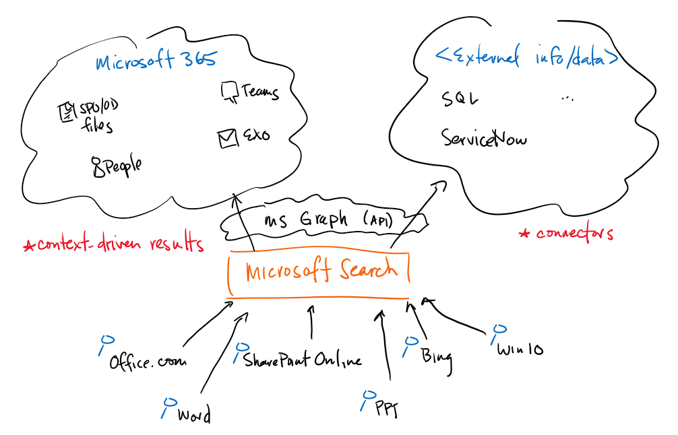

Slide 5
Demo: Microsoft Search

Slide 6
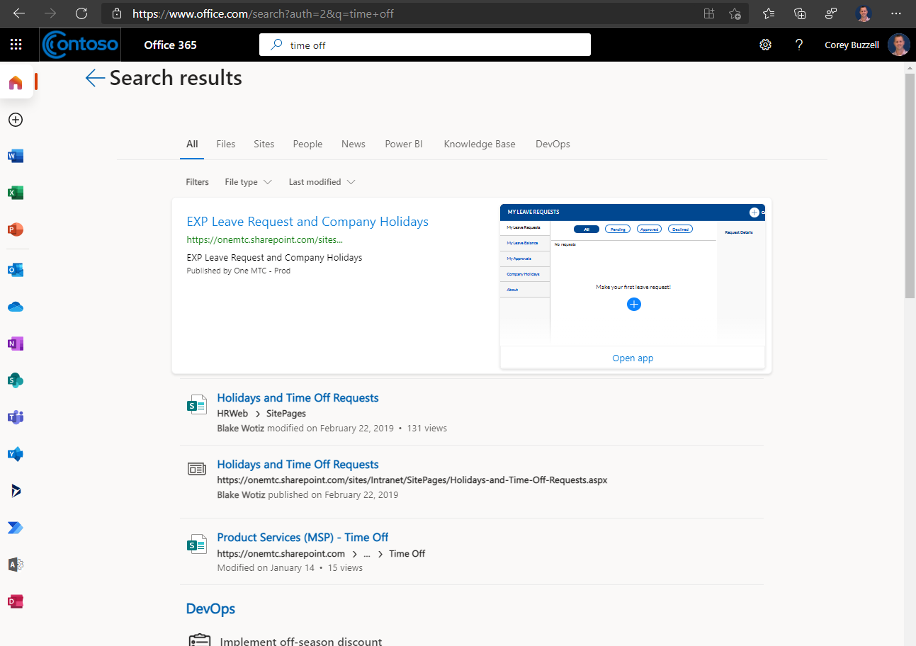
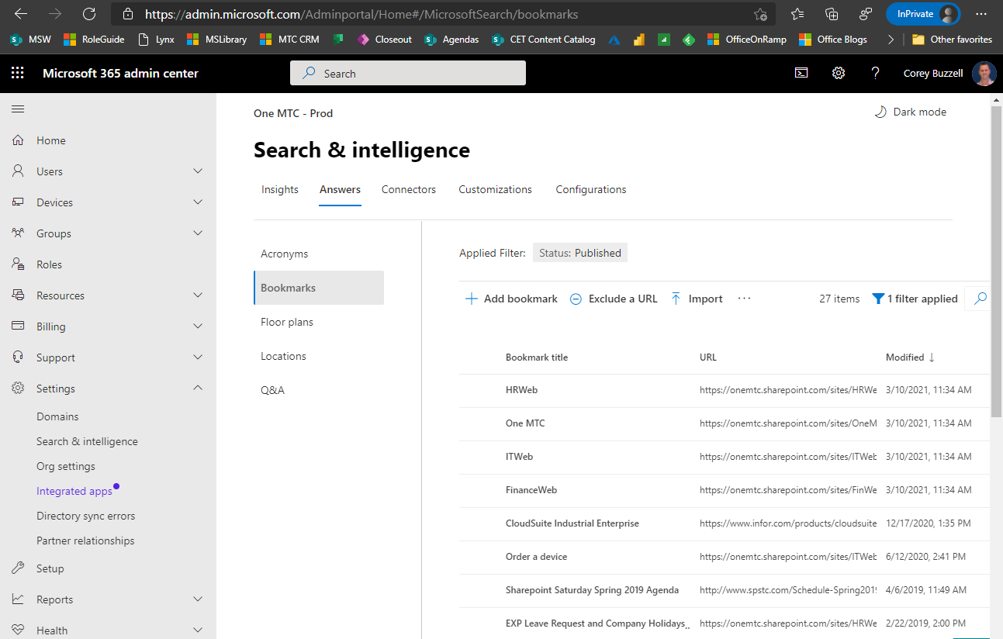

Slide 7
Knowledge repository
Let’s build a SharePoint site (using out-of-the-box components) to act as our knowledge repo and see how we can help guide folks to content.
Note: This is a more focused knowledge management use case for a specific “area”.
Assumption: you know that you can store files in SharePoint
BASIC

Slide 8
Demo: Knowledge repository in SharePoint

Slide 9
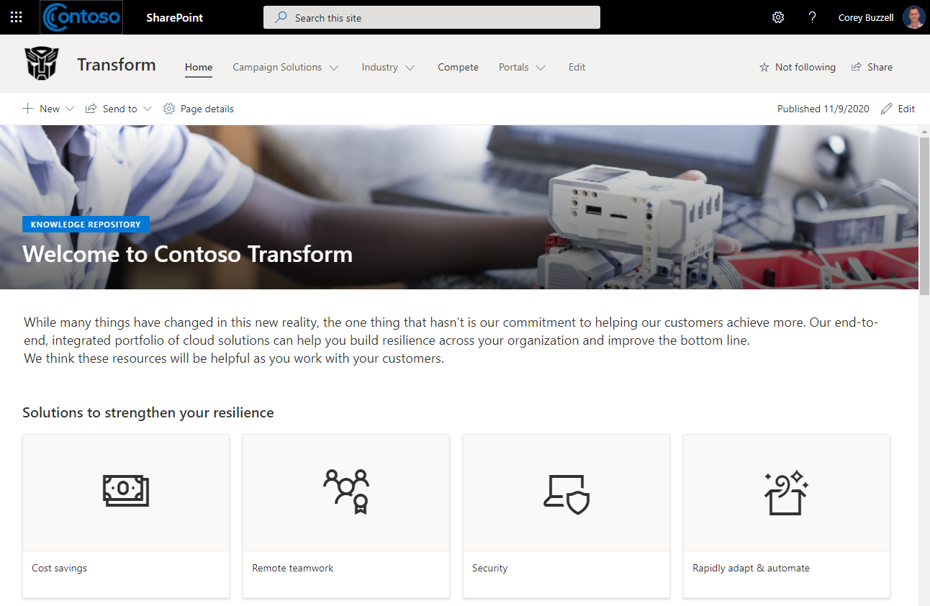
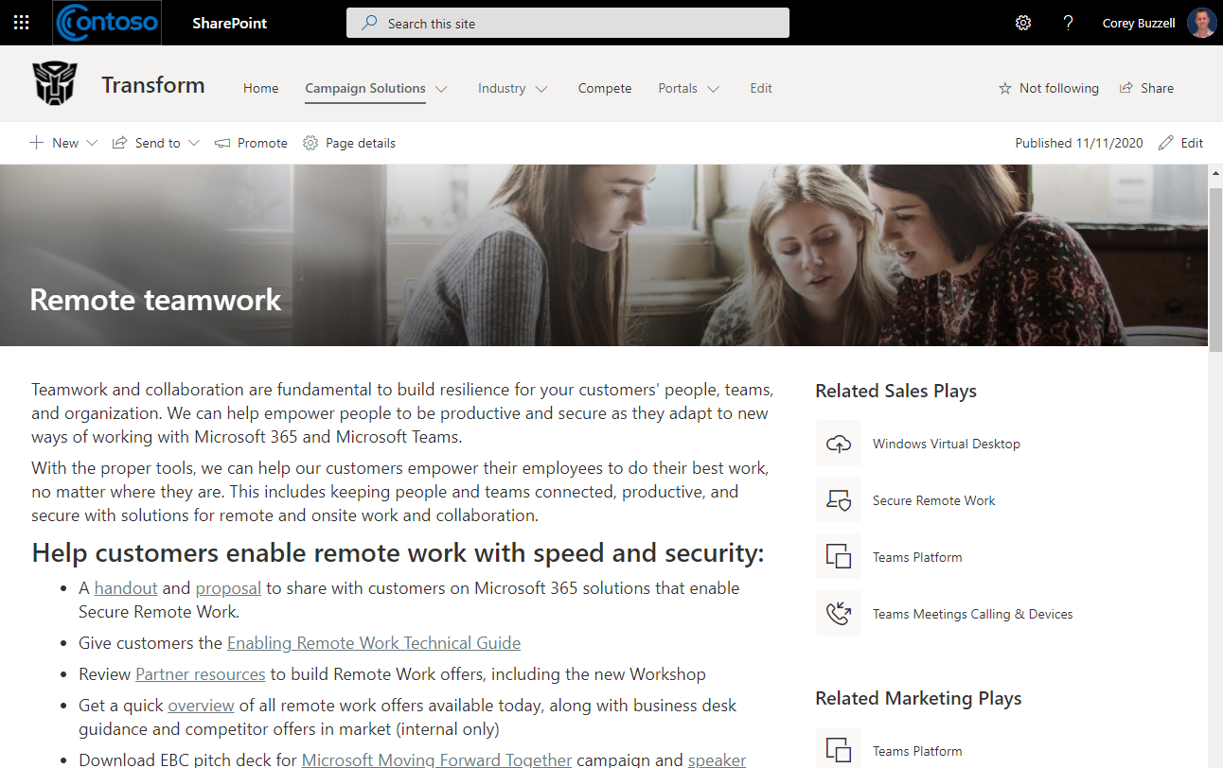
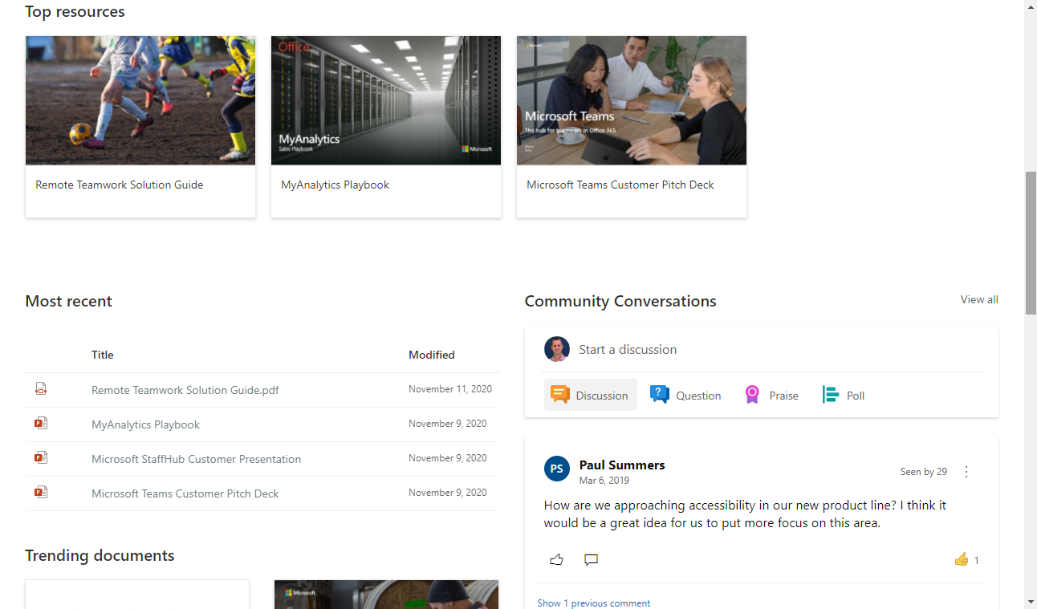
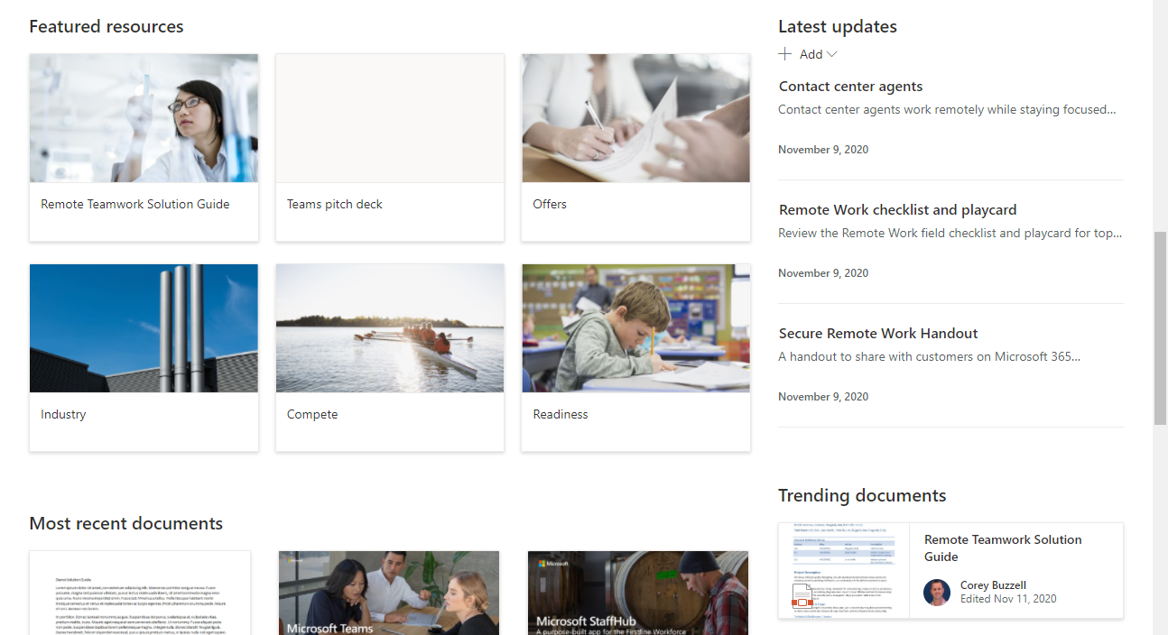
Title area: Image and title, text above title
Quick links: Compact, Icons
Text
Text
Quick links: Grid, Icons
Quick links: Grid, Custom images
Quick links: Grid, Custom images
News
Highlighted content: Sort by Most recent
Conversations (Yammer)
Highlighted content: Sort by Trending
Highlighted content: Sort by Most recent
Highlighted content: Sort by Trending

Slide 10
Custom search results
Let’s use free, open source web parts to customize our search results in our knowledge repository.
Note: Installing these custom web parts requires a SharePoint Administrator.
PnP Modern Search web parts
How to create a custom search results page
PnP Modern Search Refiners + document metadata
ADVANCED

Slide 11
Demo: Custom search results in SharePoint

Slide 12
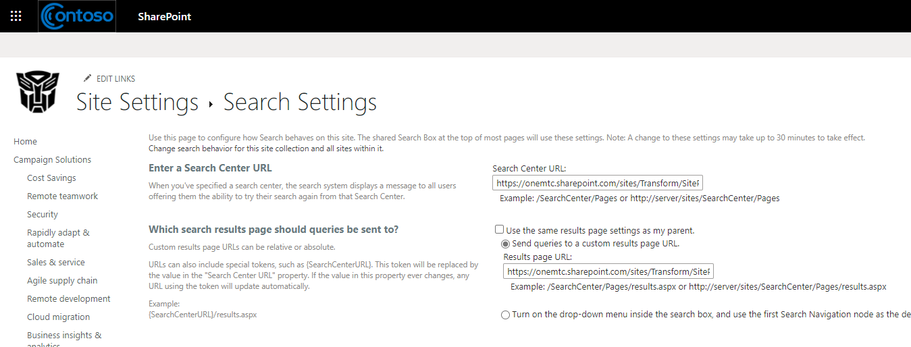
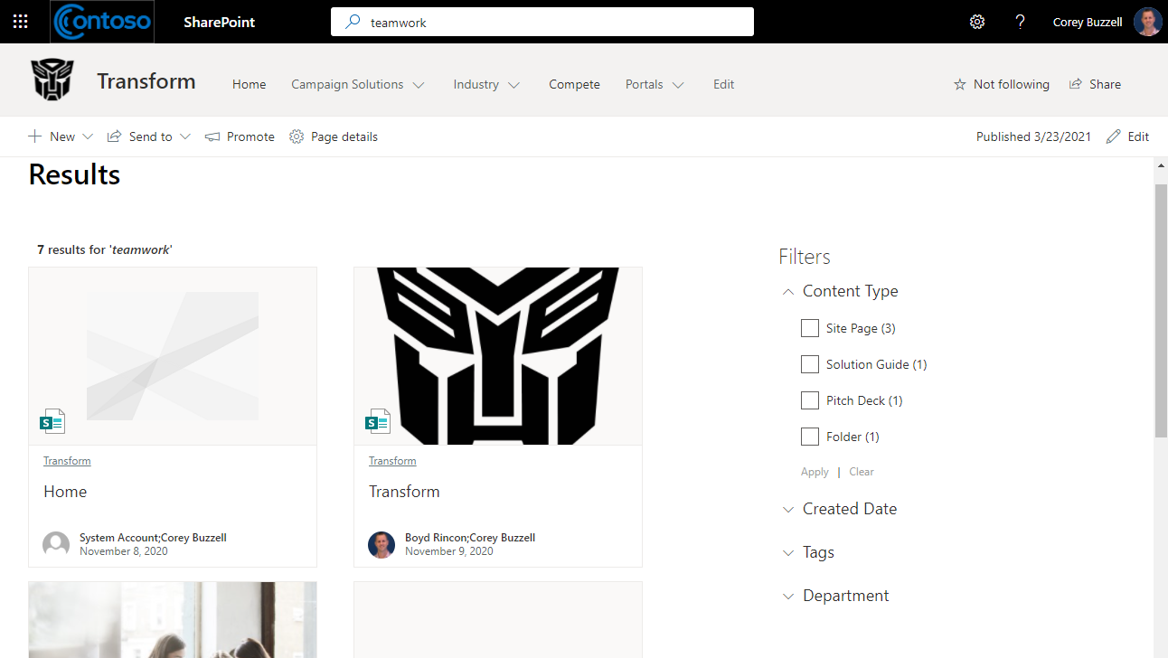
PnP – Search Results
PnP – Search Filters

Slide 13
Content Types
How can we use Content Types in SharePoint to improve search?
https://support.microsoft.com/en-us/office/introduction-to-content-types-and-content-type-publishing-e1277a2e-a1e8-4473-9126-91a0647766e5
INTERMEDIATE

Slide 14
Demo: Content Types in SharePoint

Slide 15
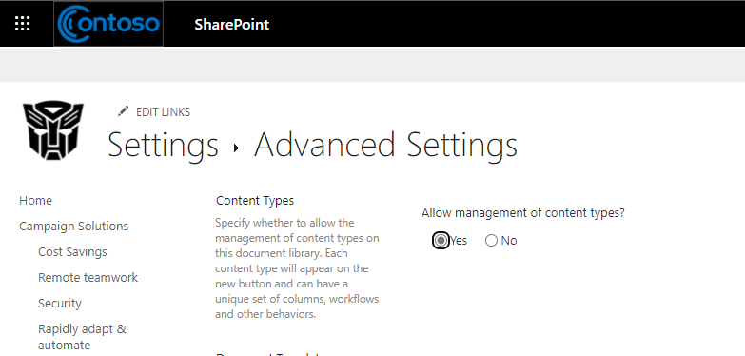
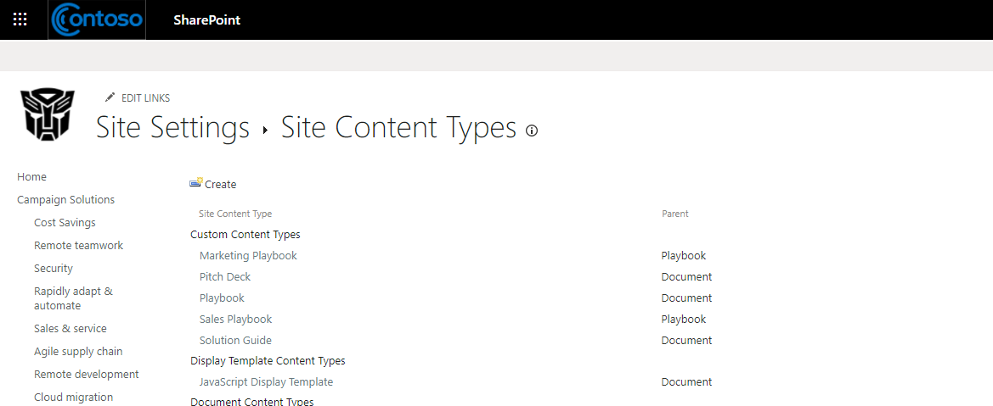
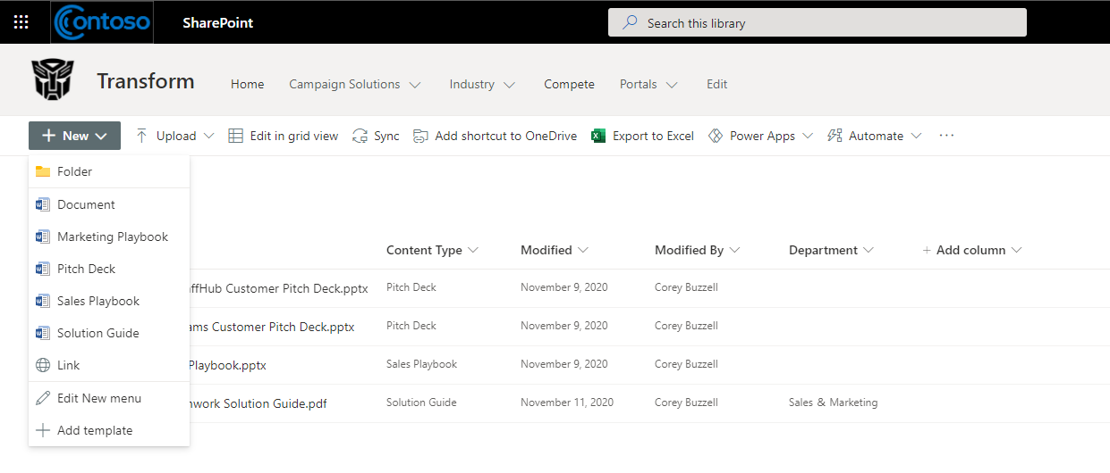
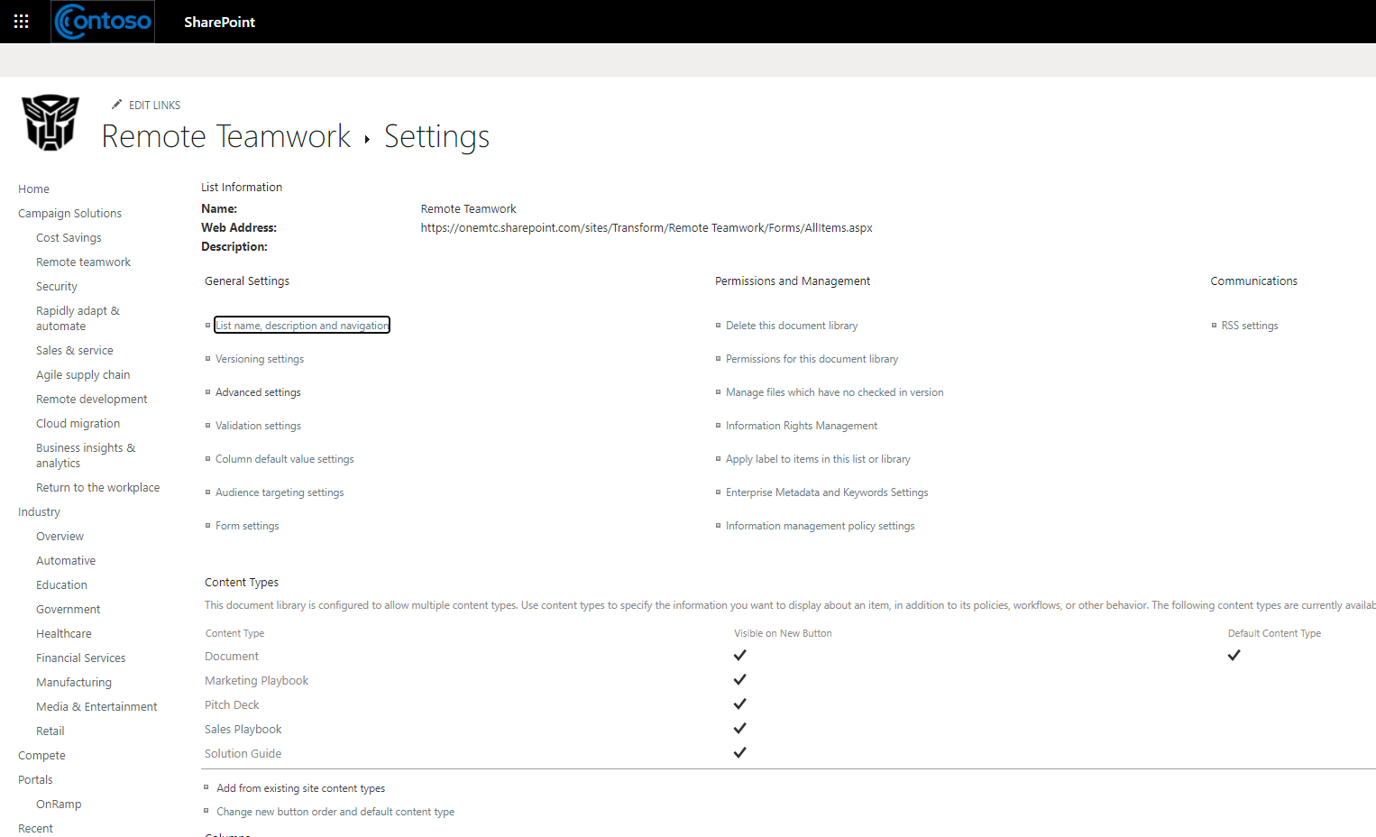

Slide 16
Communicate new content
What are some ways to communicate new content to people?
SharePoint News
Yammer + Teams
Company Communicator app in Teams
- Requires hosting and installation by Administrator
BASIC + INTERMEDIATE

Slide 17
Demo: a bunch of stuff

Slide 18
Resources
Microsoft Search
https://aka.ms/MicrosoftSearch
https://docs.microsoft.com/en-us/microsoftsearch/overview-microsoft-search
Custom search results
PnP Modern Search web parts: https://microsoft-search.github.io/pnp-modern-search
Create results page: https://docs.microsoft.com/en-us/microsoftsearch/create-search-results-pages
Use metadata in refiners: https://sympmarc.com/2020/03/22/using-the-pnp-modern-search-web-parts-with-refiners-for-site-name-and-content-type/
SharePoint Content Types
https://support.microsoft.com/en-us/office/introduction-to-content-types-and-content-type-publishing-e1277a2e-a1e8-4473-9126-91a0647766e5
Communicating new content
SharePoint News: https://support.microsoft.com/en-us/office/create-and-share-news-on-your-sharepoint-sites-495f8f1a-3bef-4045-b33a-55e5abe7aed7
Yammer Communities in Teams: https://support.microsoft.com/en-us/office/use-the-yammer-communities-app-for-microsoft-teams-930c86f1-e1e2-4e45-a66a-ce8faca71a21
Company Communicator: https://docs.microsoft.com/en-us/microsoftteams/platform/samples/app-templates#company-communicator

Slide 19
Questions?

